Slide 1



DATABASE SYSTEMS BY MARIA RAHIM
TERM PROJECT

Slide 2

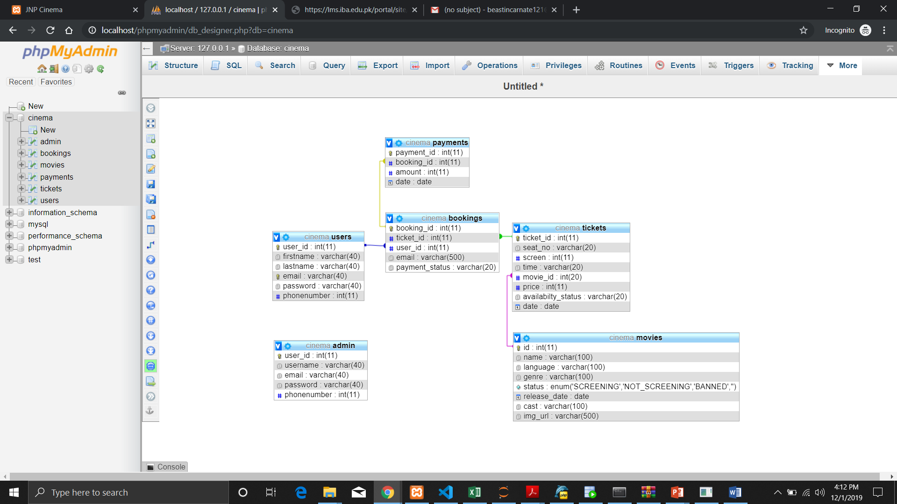
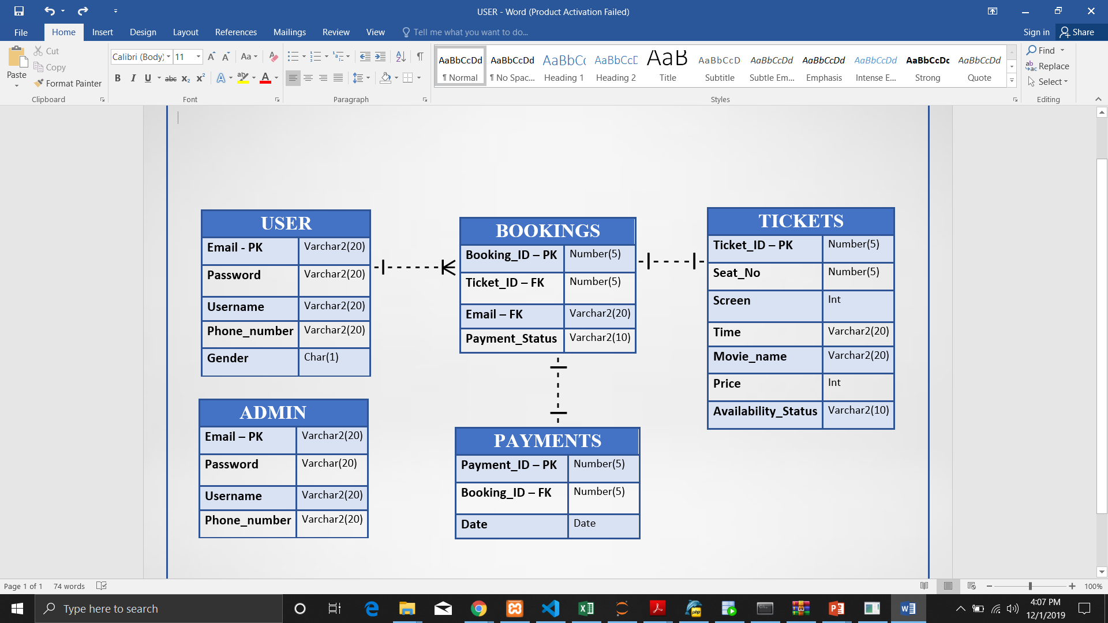
Proposed ERD
Implemented ERD

Slide 3
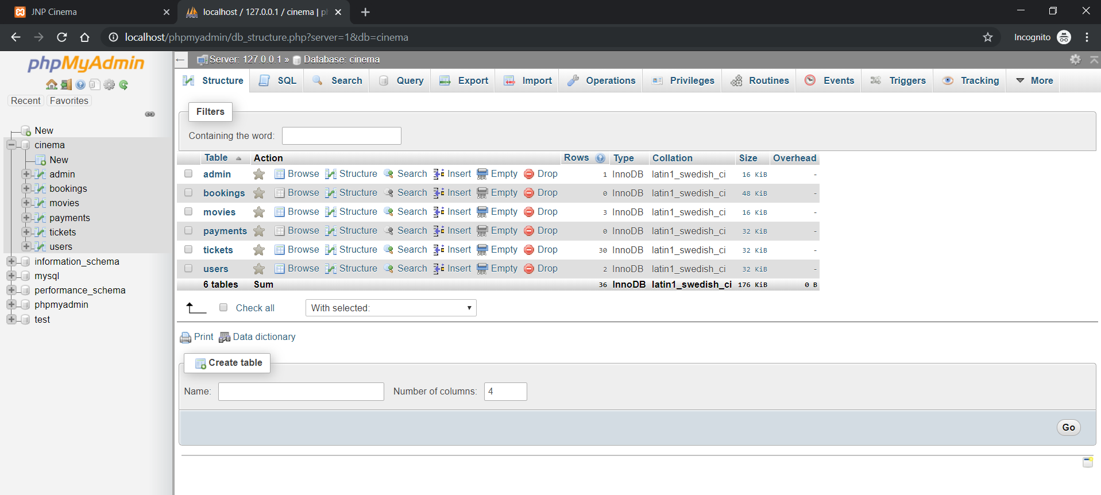
phpMyAdmin (cinema) DataBase

Slide 4
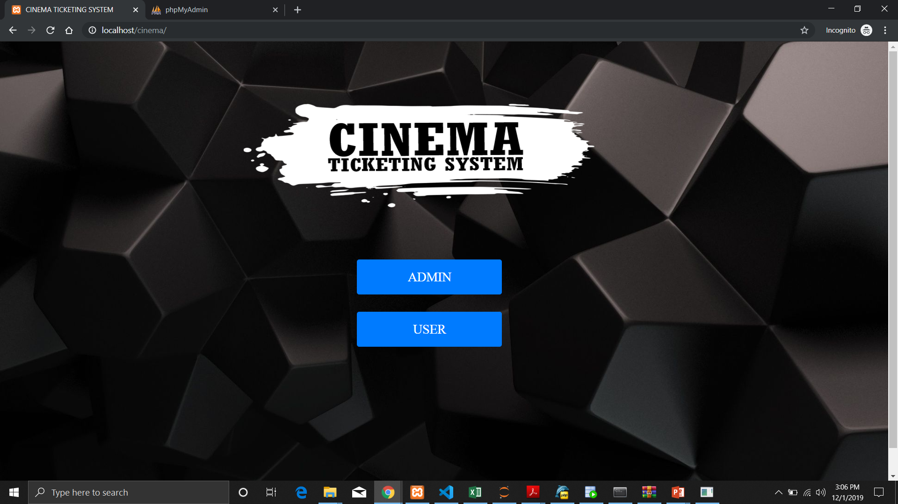
Index.php

Slide 5
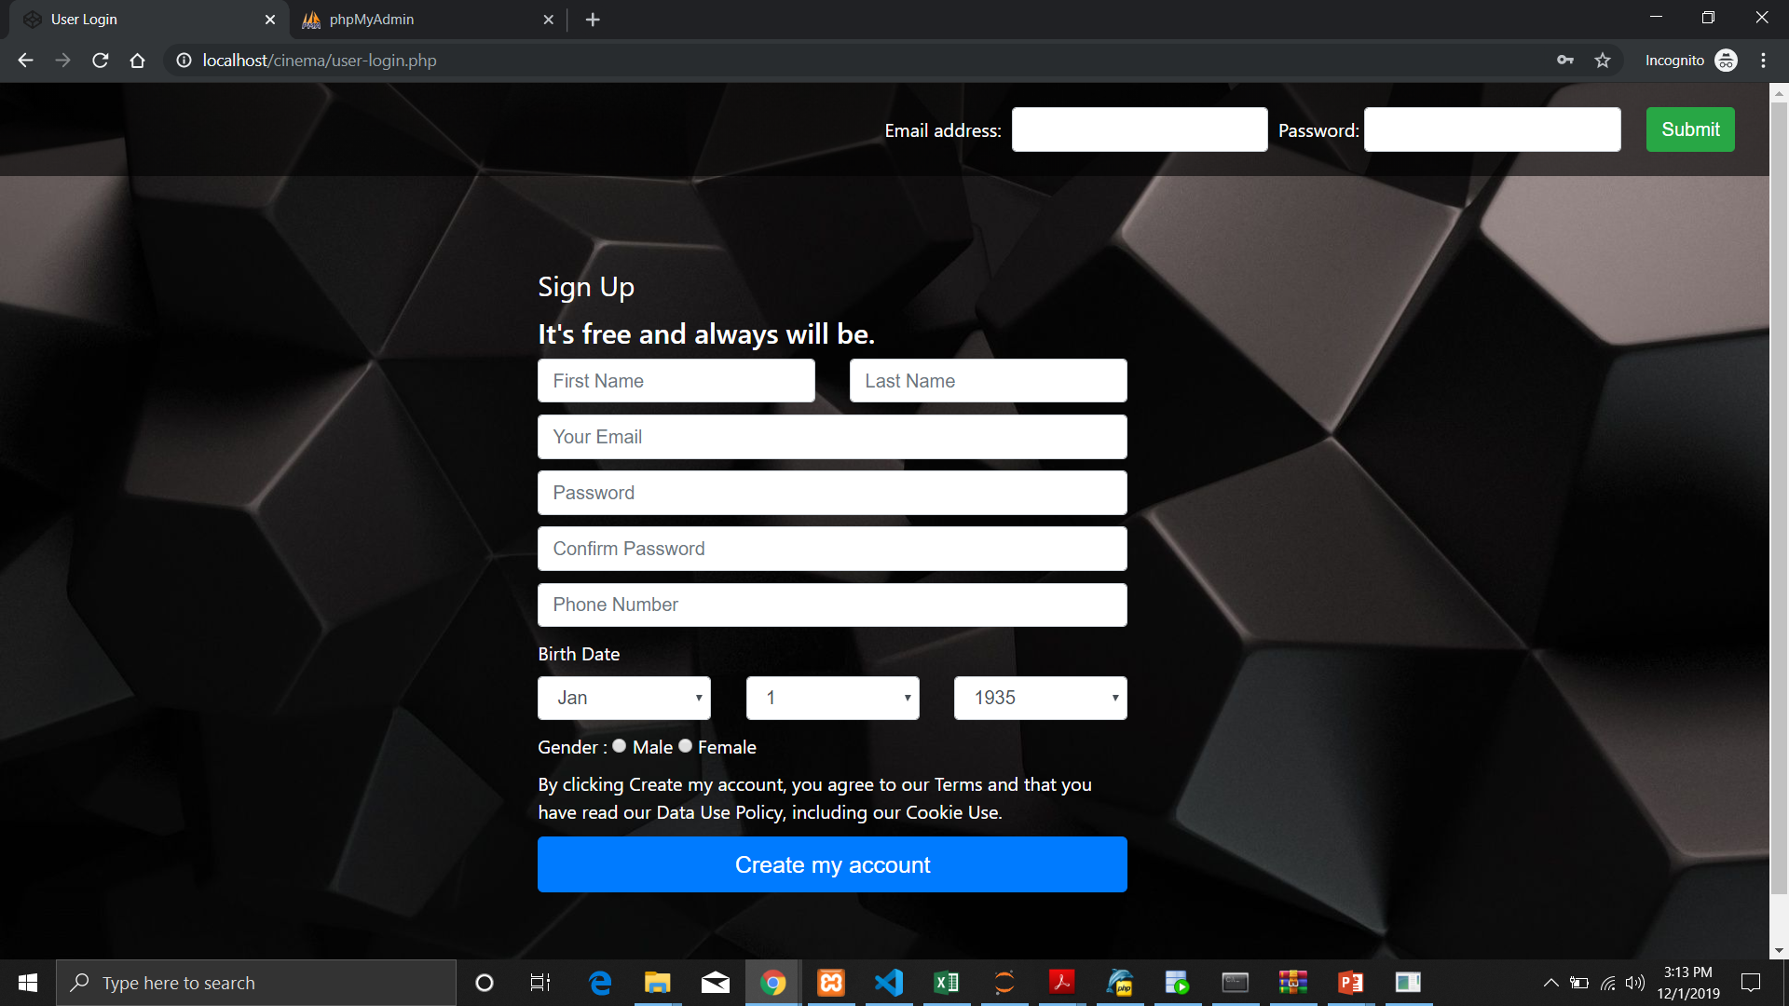
User Registration/Login Portal

Slide 6
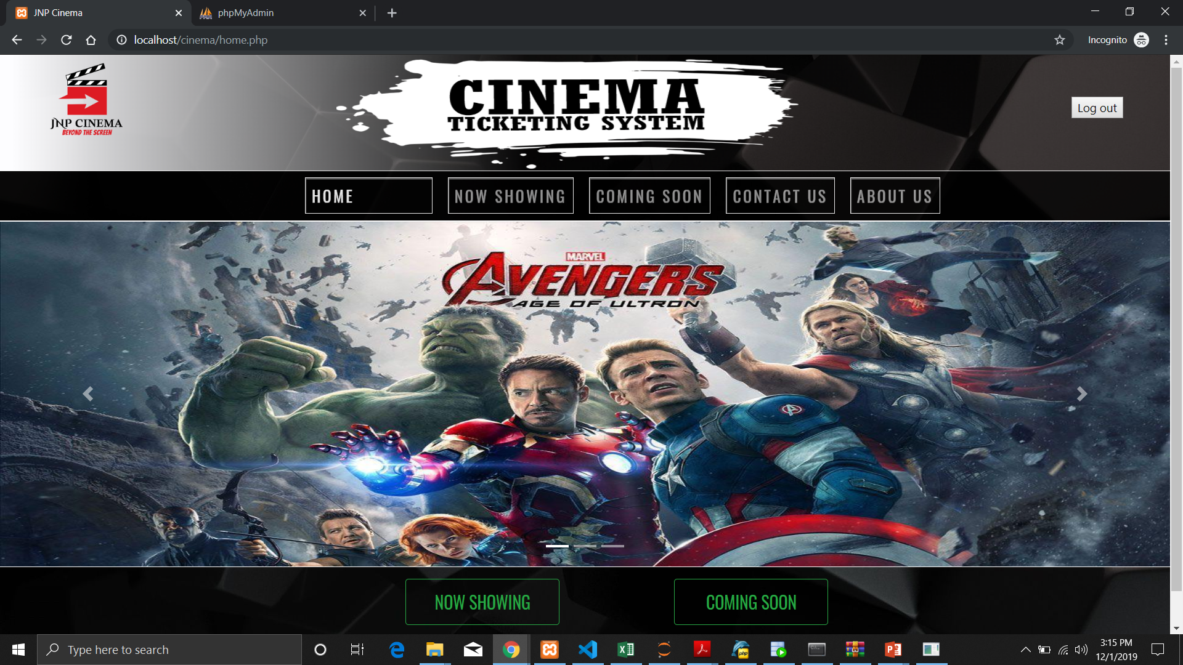
Home.php

Slide 7
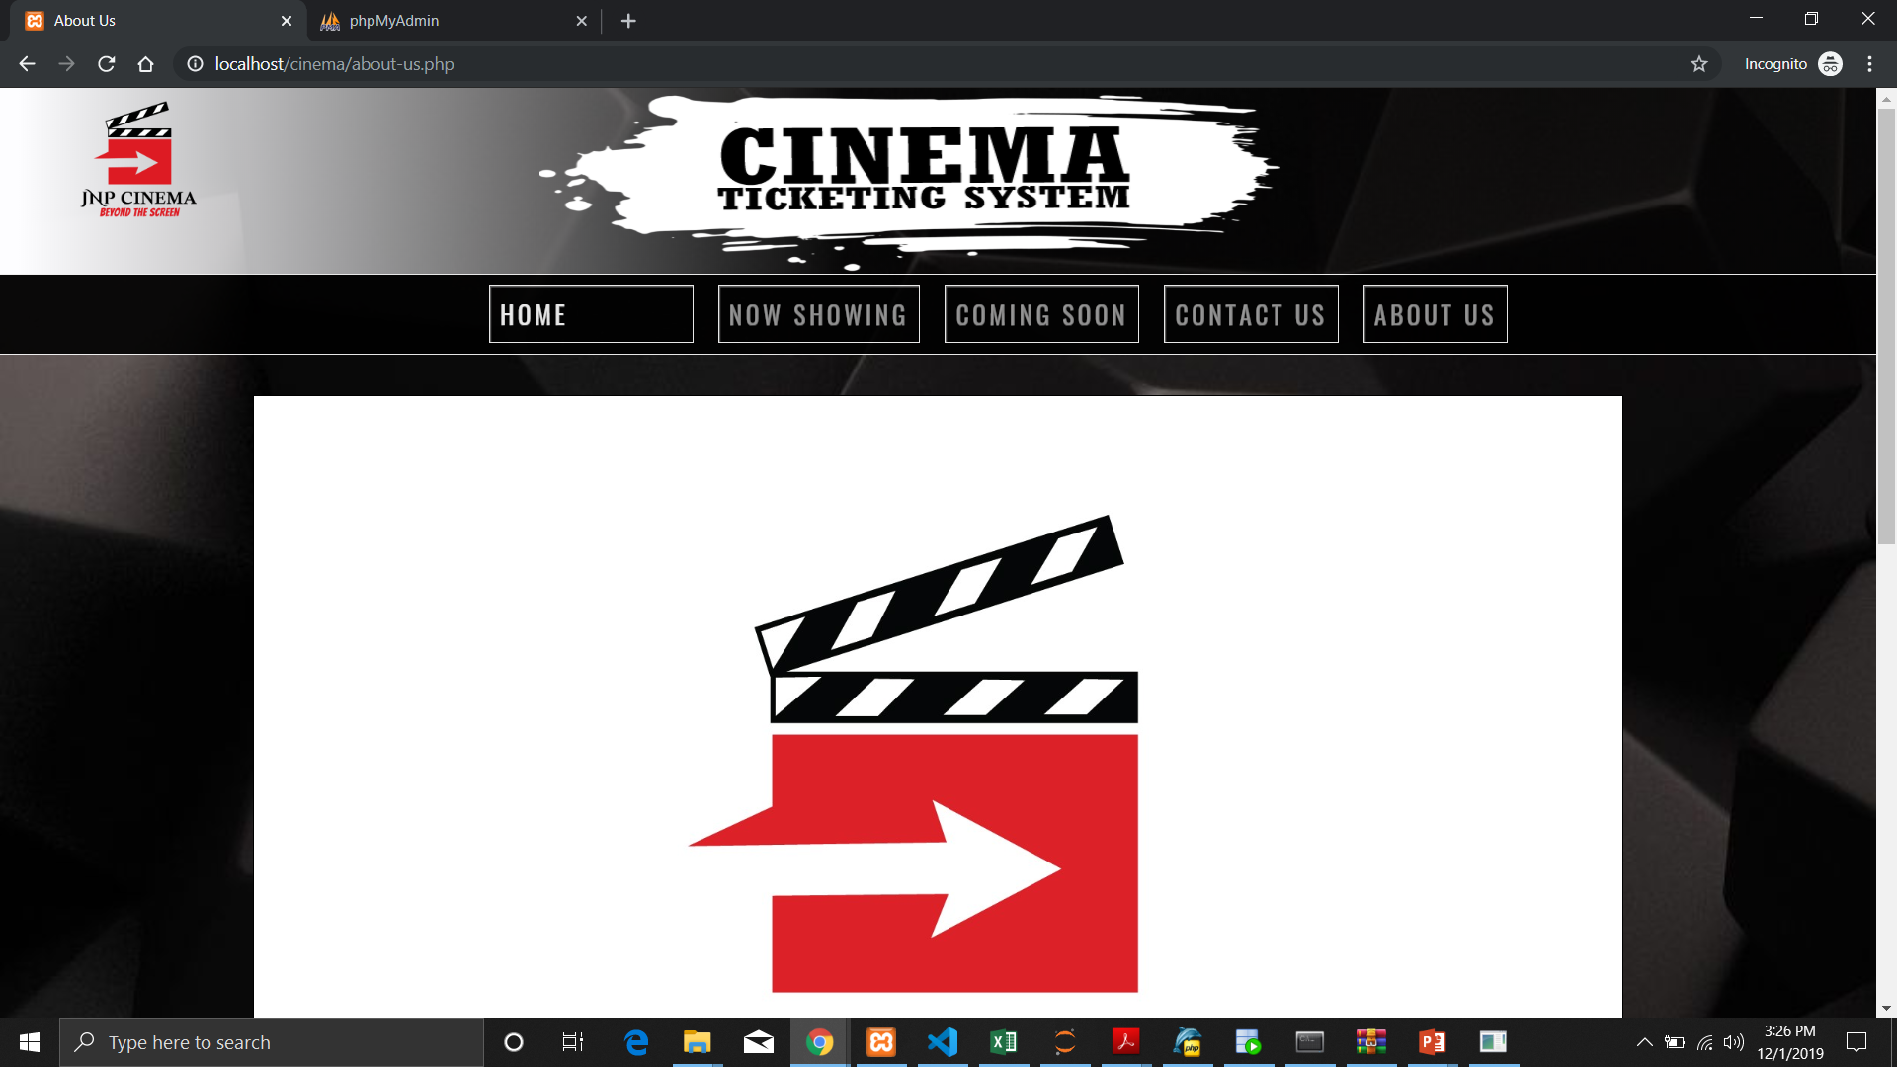
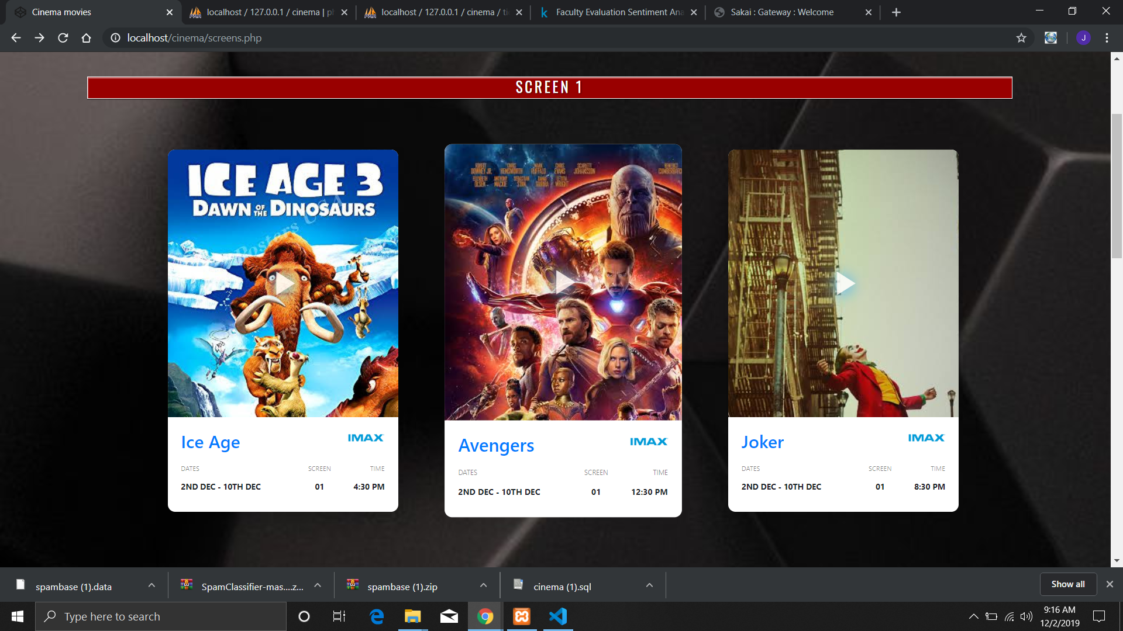
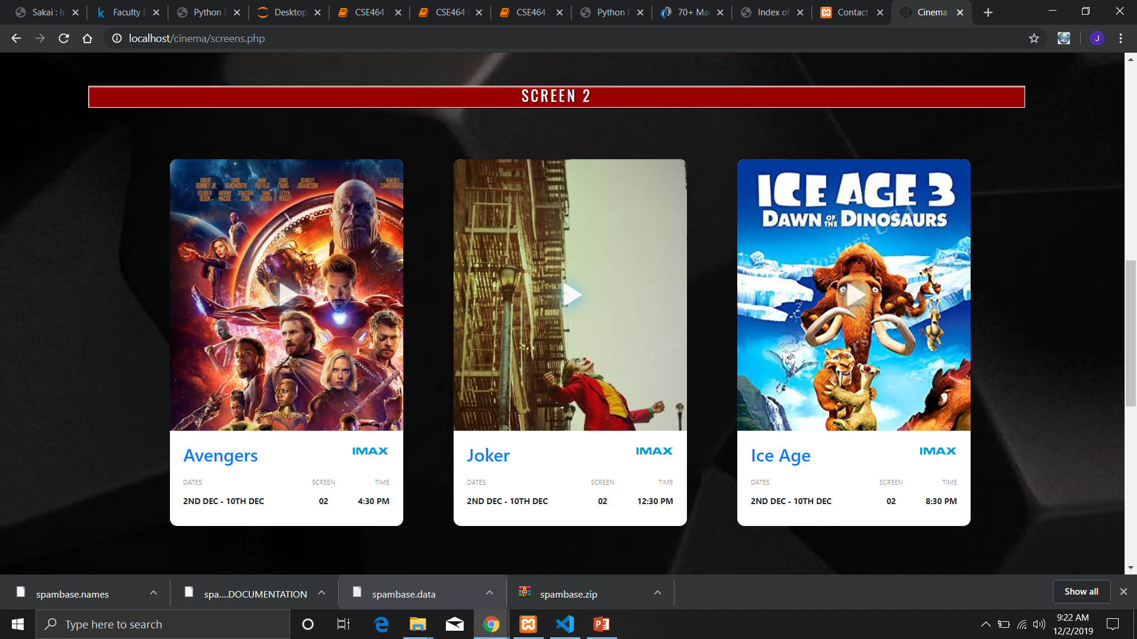
Screens.php

Slide 8
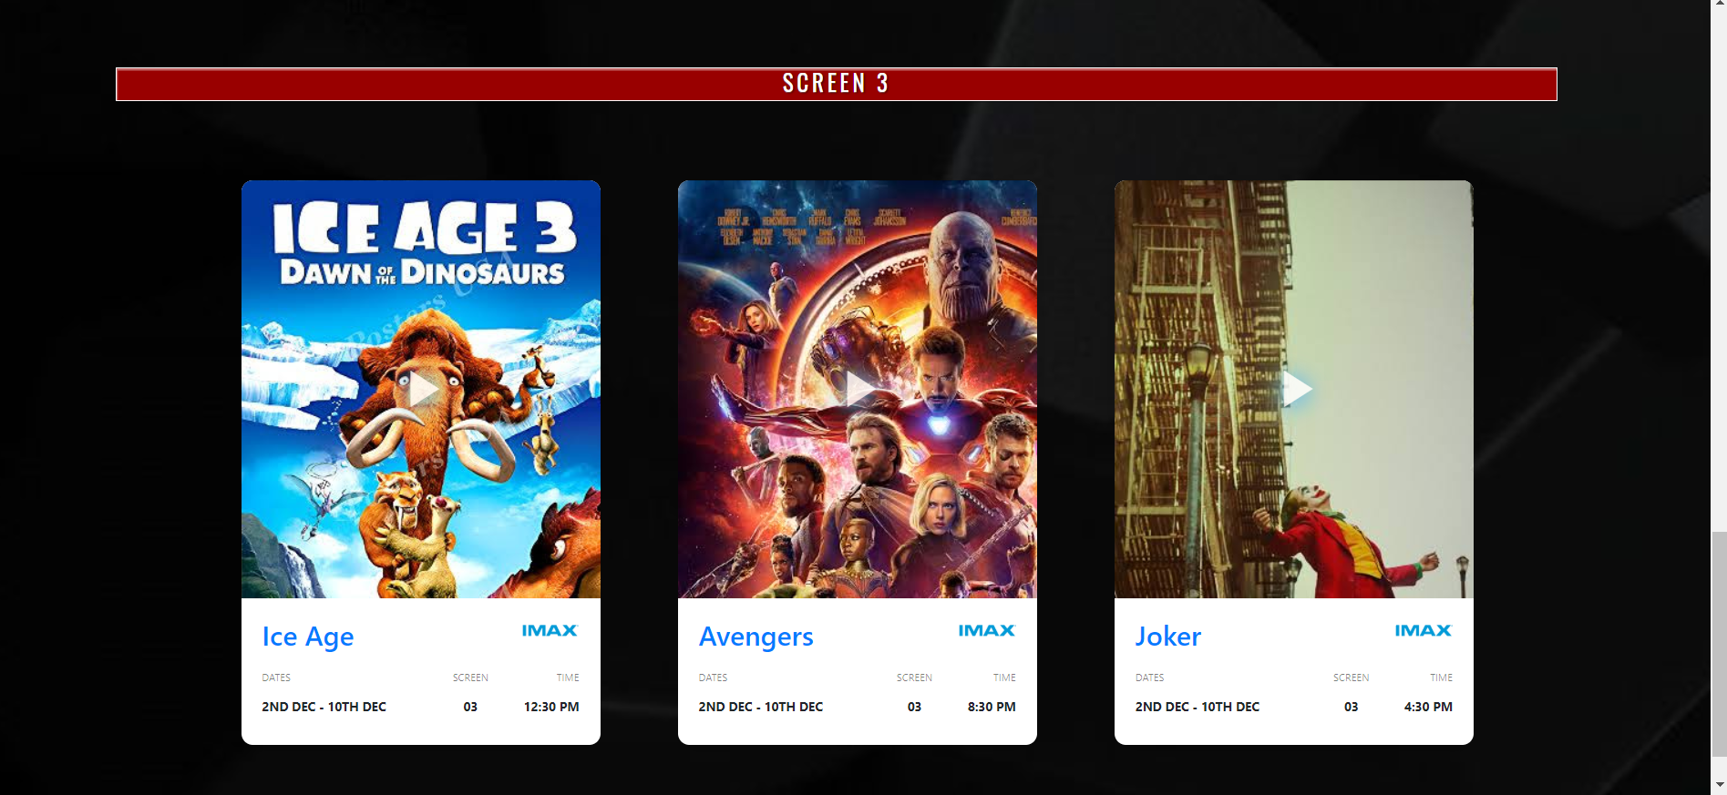
Screens.php

Slide 9
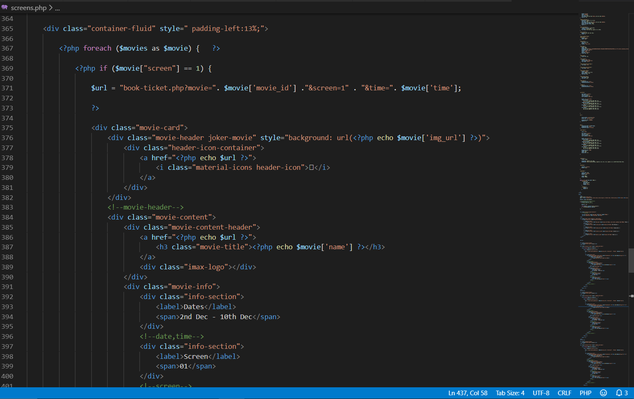
Dynamic data from Database (Screen 1)

Slide 10
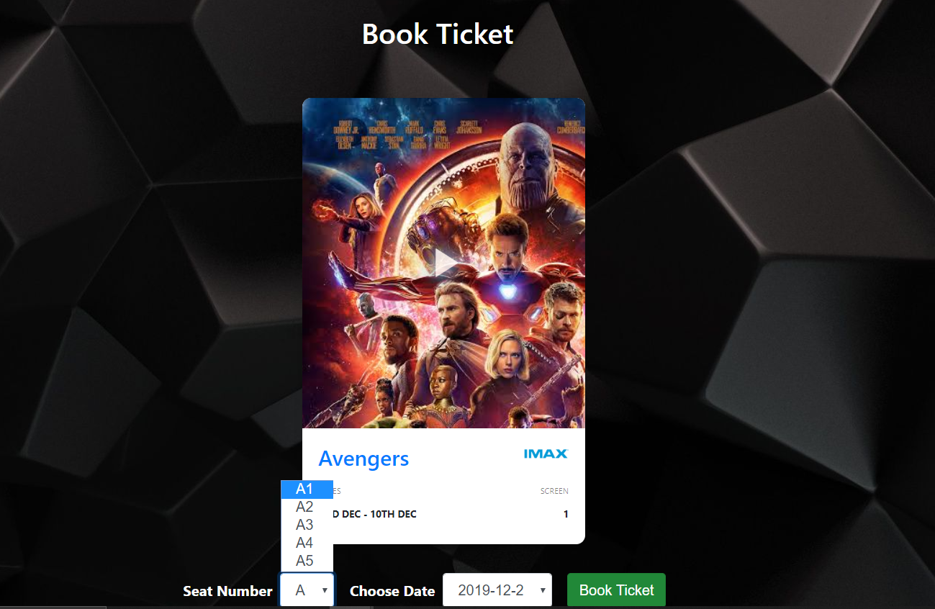
Book-ticket.php

Slide 11
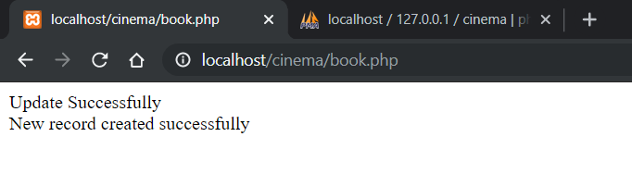
Book.php

Slide 12
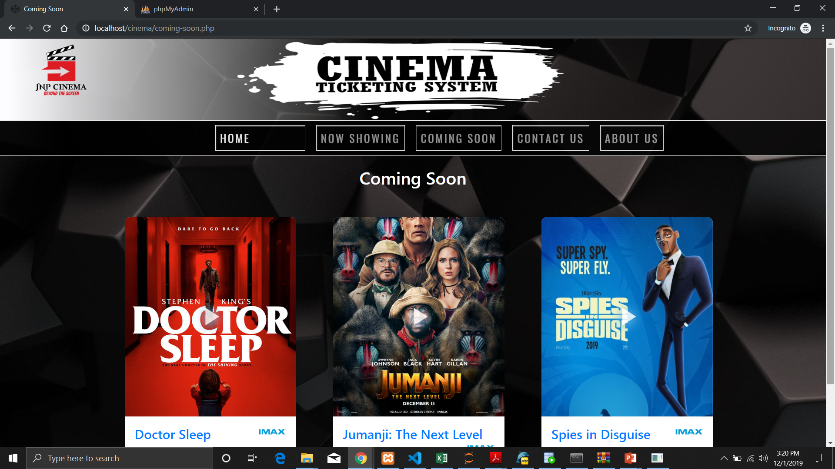
Coming-soon.php

Slide 13
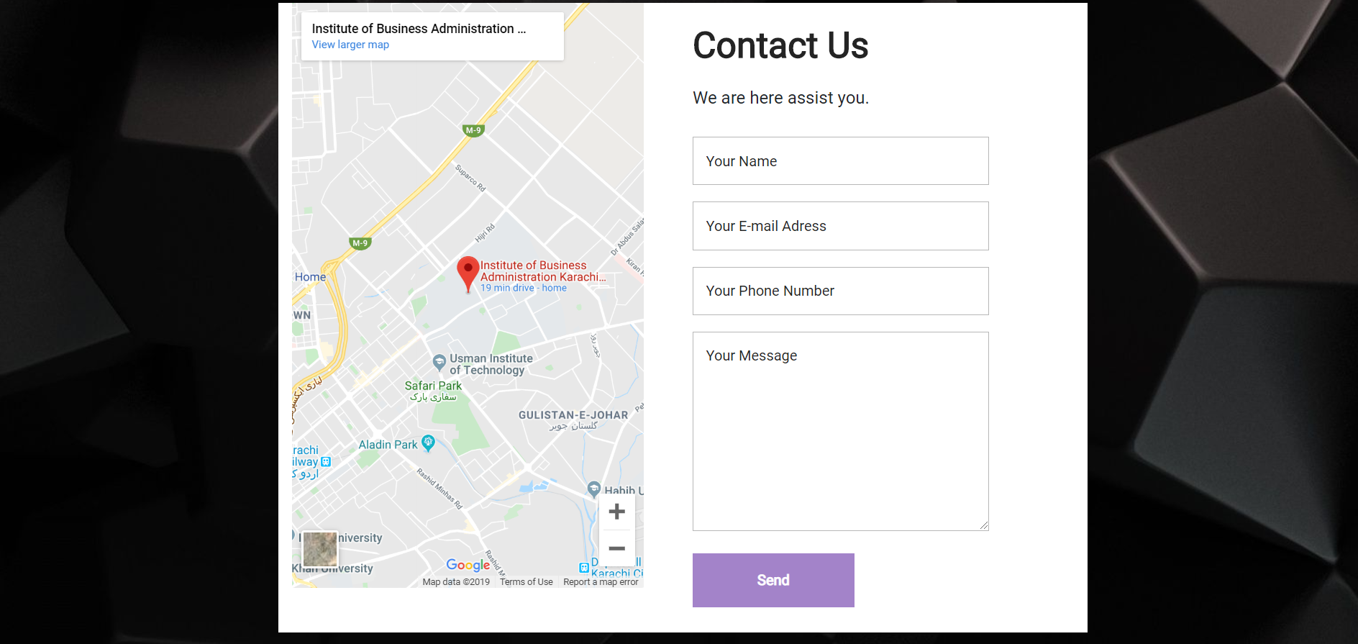
Contact-us.php

Slide 14
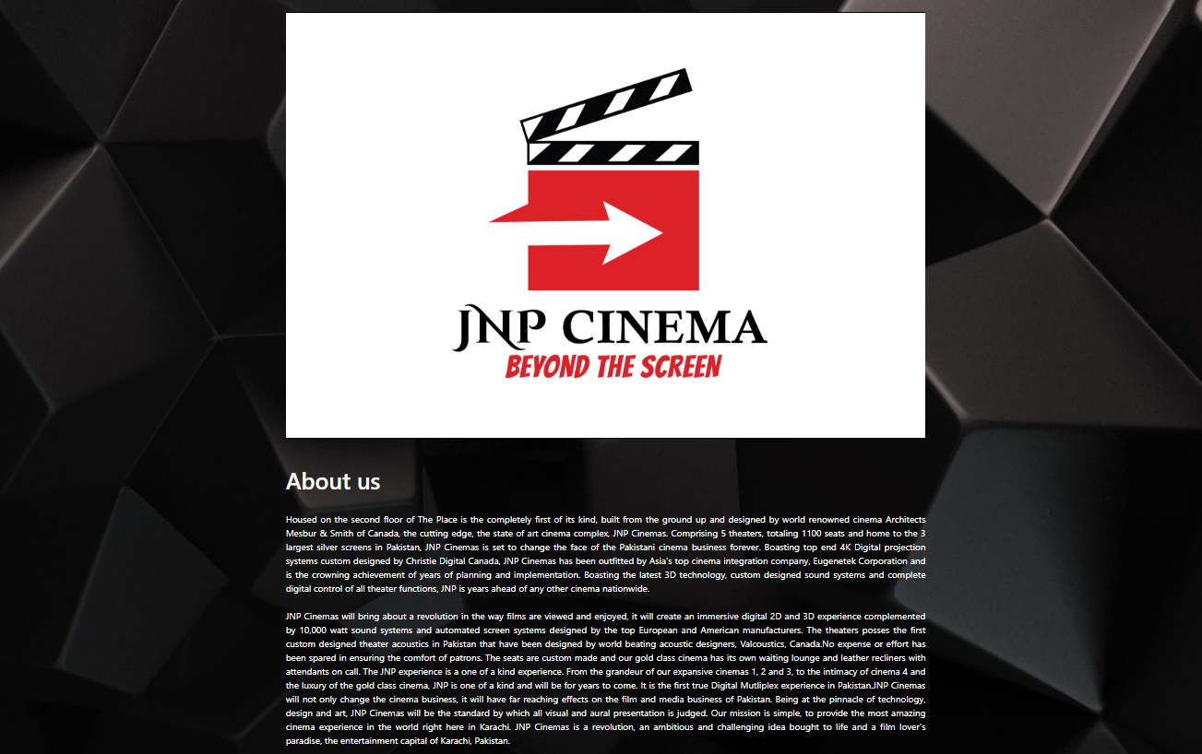
About-us.php

Slide 15
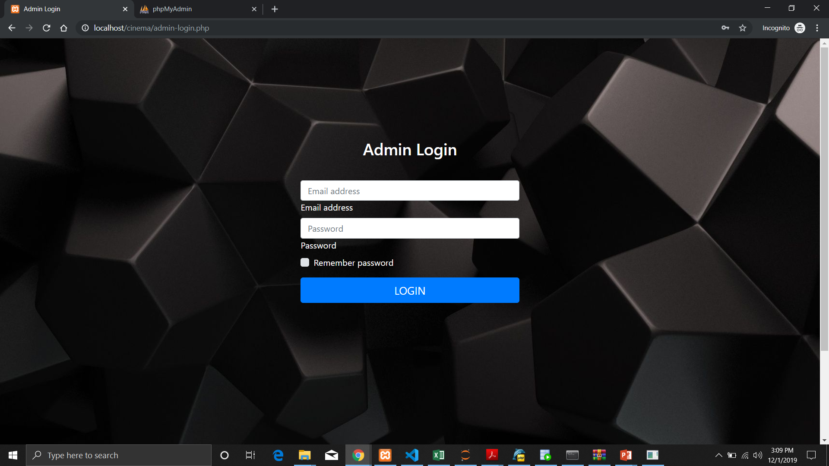
Admin Login

Slide 16
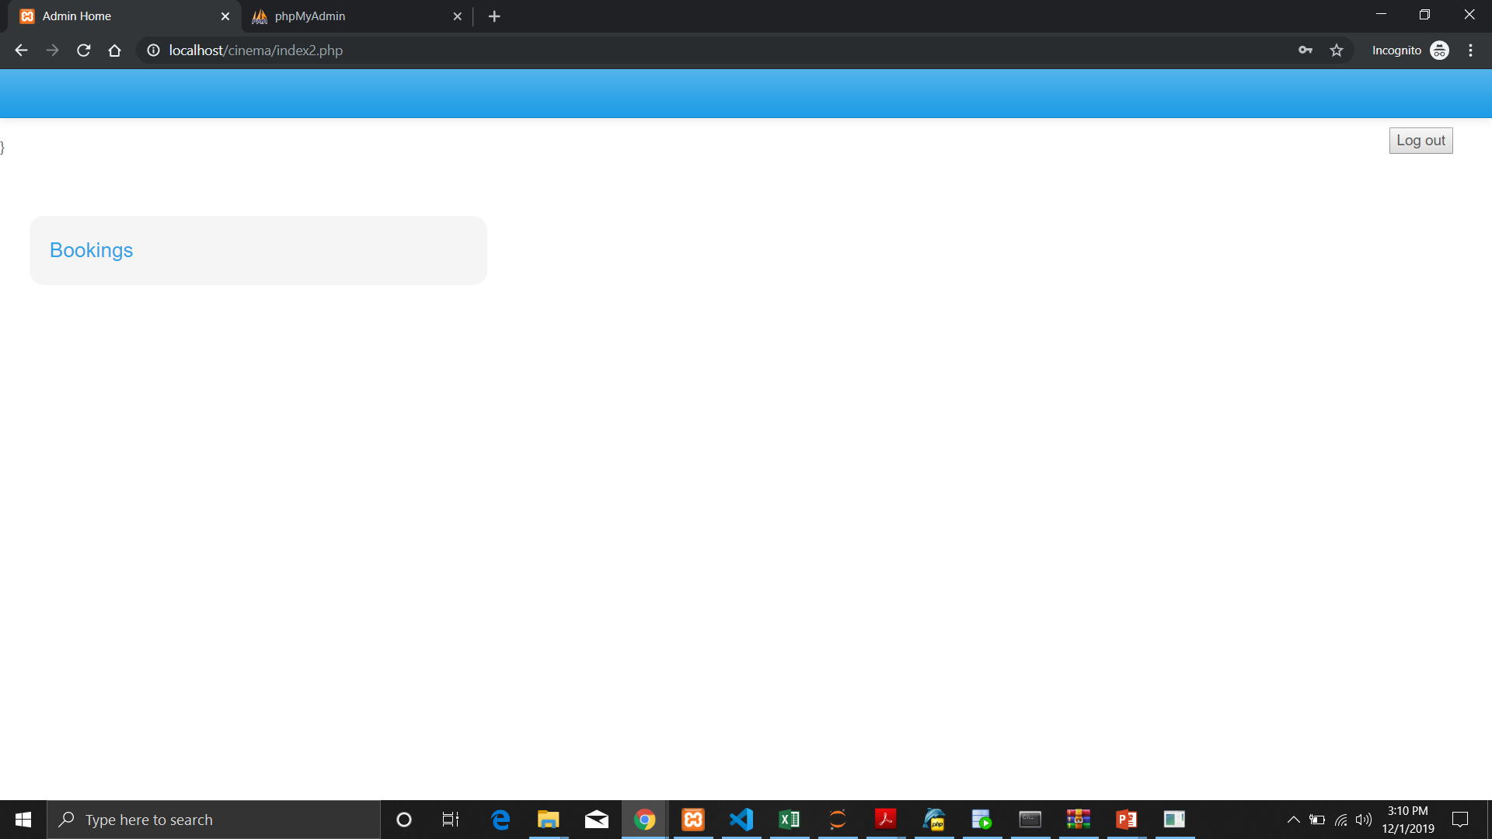
Admin Home

Slide 17
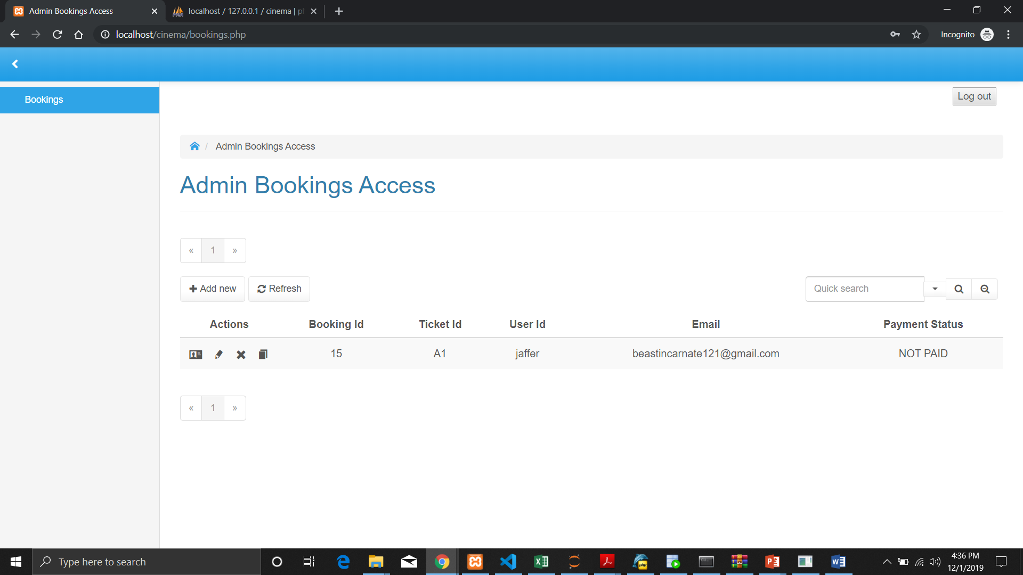
Admin Bookings Access

Slide 18
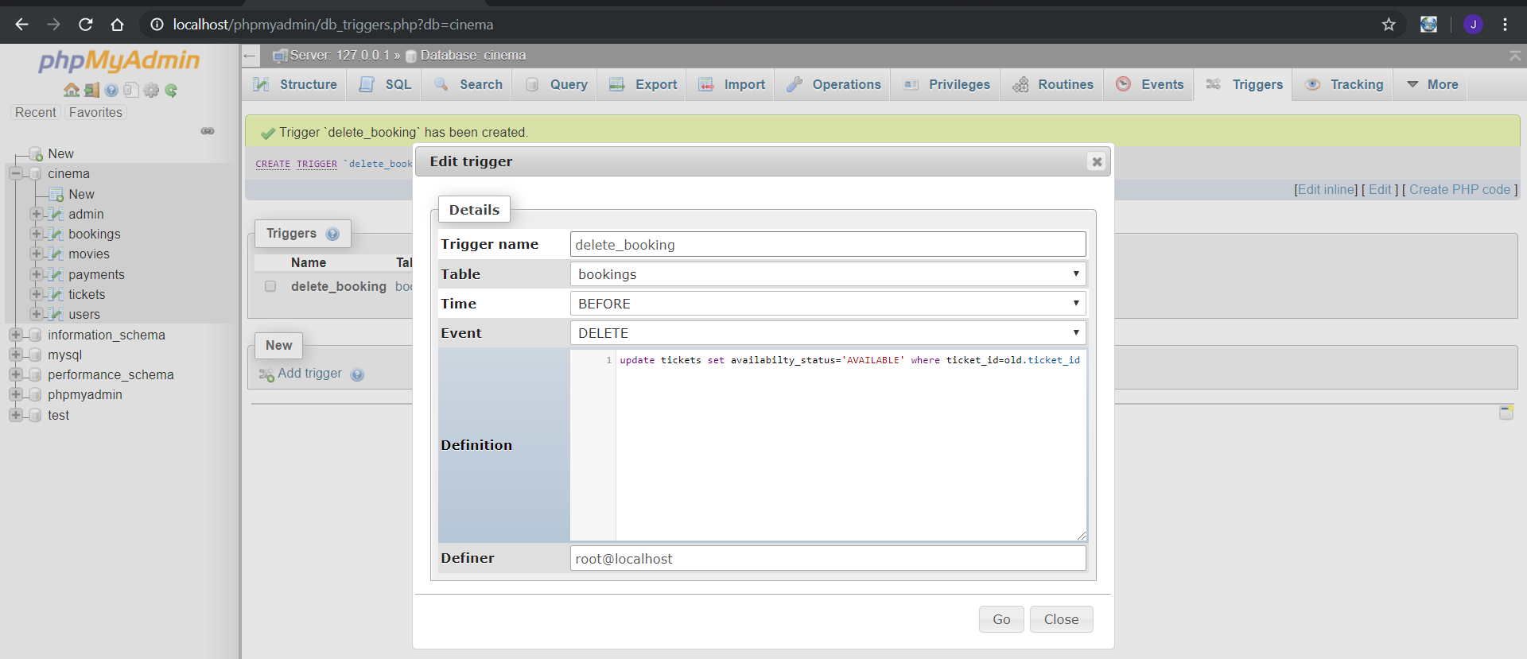
Triggers on delete from booking

Slide 19


